Slide 1


Open Public Meetings Act
RCW 42.30
Open Government Training for
Newly Elected Officials in Two Acts
Public Records Act
RCW 42.56
December 9, 2020
Training Prepared by Washington State Attorney General’s Office

Slide 2
Local Government Public Records Consultation Program
The program assists local government agencies by providing information and assistance to local agencies for developing PRA best practices, including but not limited to:
  Responding to records requests.
  Seeking additional public and private resources for developing and updating technology information services.
  Mitigating liability and costs of compliance.
No cost to the agency.
Contact: Morgan Damerow (360) 570-3418
  PRAConsultation@atg.wa.gov
Web page: www.atg.wa.gov/pra-consulting-program

Slide 3
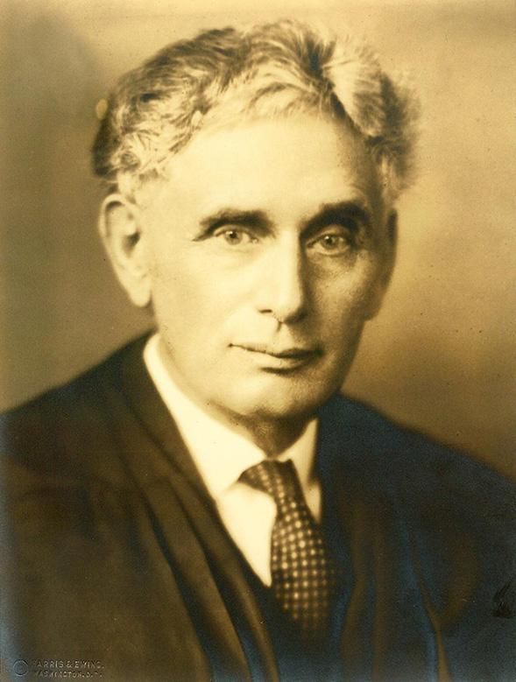
Washington’s Open Government Laws
Open Government Laws like the OPMA and the PRA are often called “Transparency Laws” or
“Sunshine Laws” because they “shine light” on government.
"Sunlight is the best disinfectant.”
“It has been said time and again in our history by political and other observers that an informed and active electorate is an essential ingredient, if not the sine qua non* in regard to a socially effective and desirable continuation of our democratic form of representative government.”
~ Washington State Supreme Court ~
U.S. Supreme Court Justice Louis Brandeis
Transparency builds public confidence in government.

Slide 4
Open Public Meetings Act
Act I
Chapter 42.30 RCW

Slide 5
Washington’s Open Public Meetings Act (OPMA)
The Open Public Meetings Act (“OPMA”), chapter 42.30 RCW, was passed by the Legislature in 1971.
It was part of a nationwide effort to make government affairs more open, accessible and responsive.
It was modeled on a California law known as the "Brown Act" and a similar Florida statute.
Requires meetings to be open to the public, gavel to gavel.
Codified at chapter 42.30 RCW.
Replaced prior “open meetings law” at chapter 42.32 RCW which was far more limited in its scope.

Slide 6

Proclamation 20-28.12
Open Public Meetings Act and
Public Records Act
Suspends identified OPMA provisions, expired December 7, 2020 at 11:59 pm. (Extended?)
Focus is on reducing in-person contact.
Prohibition on conducting a public meeting subject to RCW 42.30 unless:
  (a) the meeting is not conducted in-person and instead provides an option(s) for the public to attend the proceedings through, at minimum, telephonic access, and may also include other electronic, internet or other means of remote access, and
  (b) provides the ability for all persons attending the meeting to hear each other at the same time.
Counties currently in Phase 3 of the Safe Start Plan may, at their option, in addition to hosting the remote meeting elements described above, may include an in-person component to a public meeting provided they satisfy required meeting criteria.
Proclamation 20-28.12 also suspends provisions of the Public Records Act, RCW 42.56. (See Part II.)

Slide 7
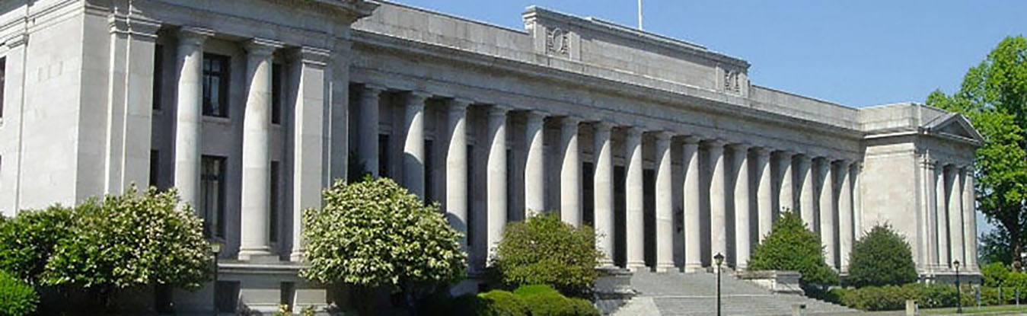
Purpose
“The people do not yield their sovereignty to the agencies which serve them. The people, in delegating authority, do not give public servants the right to decide what is good for the people to know and what is not good for them to know. The people insist on remaining informed so they may retain control over the instruments they have created.”
Public commissions, boards, councils, etc. listed in OPMA are agencies of this state that exist to aid in the conduct of the people’s business.
Their actions are to be taken openly and deliberations conducted openly.
RCW 42.30.010
The purpose of the OPMA is to allow the public to view the “decision making process.”
Washington State Supreme Court

Slide 8
The OPMA Applies To
All meetings of the governing body of a public agency shall be open and public and all persons shall be permitted to attend any meeting of the governing body of a public agency, except as otherwise provided in RCW 42.30.
RCW 42.30.030
What is a Governing Body?
Any committee of such public agency when:
  the committee acts on behalf of the governing body,
  conducts hearings, or
  takes testimony or public comment.
The multimember board or other policy or rule-making body of a public agency.
OR
RCW 42.30.020

Slide 9
What is a Public Agency
Any state board, commission, committee, department, educational institution, or other state agency which is created by or pursuant to statute, other than courts and the legislature.
Any county, city, school district, special purpose district, or other municipal corporation or political subdivision of Washington State.
Any subagency of a public agency which is created by or pursuant to statute, ordinance, or other legislative act, including but not limited to planning commissions, library or park boards, commissions, and agencies.
Any policy group whose membership includes representatives of publicly owned utilities formed by or pursuant to the laws of this state when meeting together as or on behalf of participants who have contracted for the output of generating plants being planned or built by an operating agency.
RCW 42.30.020

Slide 10
The OPMA Does Not Apply To
These entities:
  Courts
  Legislature
  Agencies not defined as “public agency” in OPMA, such as agencies governed by a single individual
  Private organizations
These activities:
  Licensing/permitting for businesses, occupations or professions or their disciplinary proceedings (or proceedings to receive a license for a sports activity, or to operate a mechanical device or motor vehicle)
  Quasi-judicial matters
  Matters governed by the Washington Administrative Procedure Act, RCW 34.05
  Collective bargaining
RCW 42.30.020(1), RCW 42.30.140

Slide 11
What is a Meeting?
“Meeting” means meetings at which the public agency takes “action.”
“Action” means the transaction of the official business of the public agency and includes but is not limited to:
    - Public testimony - All deliberations
    - Discussions - Considerations
    - Reviews - Evaluations
    - Final actions*
    * The requirements of the OPMA are triggered whether or not “final” action is taken.
    (See upcoming slide on “final action.”)
RCW 42.30.020; Citizens Alliance for Property Rights Legal Fund v. San Juan County

Slide 12

“Meeting” (Cont.)
A “meeting” of a governing body occurs when a majority of its members (quorum) gathers with the collective intent of transacting the governing body’s business.
  Physical presence not required – a meeting can occur by phone or email.
  An exchange of email could constitute a meeting if, for example, a quorum of the members participate in the email exchange & discuss agency business. Simply receiving information without comment is not a meeting.
        Wood v. Battle Ground School District; Citizens Alliance for Property Rights Legal Fund v. San Juan County
  Does not need to be titled “meeting” – OPMA also applies to “retreats,” “workshops,” “study sessions,” etc.
No meeting occurs if the governing body lacks a quorum.

Slide 13
Final Action
“Final action” is a collective positive or negative decision, or an actual vote, by a majority of the governing body, or by the “committee thereof.”
Must be taken in public, even if deliberations were in closed session.
Secret ballots are not allowed.
RCW 42.30.060, RCW 42.30.020

Slide 14


Travel and Gathering
A majority of the members of a governing body may travel together or gather for purposes other than a regular meeting or a special meeting, so long as no action is taken.
Discussion or consideration of official business would be action, triggering the requirements of the OPMA.
RCW 42.30.070

Slide 15
OPMA MEETING TYPES
Regular
Special
Emergency
Notice and agenda requirements vary based on the type of meeting.

Slide 16
Regular Meetings
“Regular meetings” are recurring meetings held in accordance with a periodic schedule by ordinance, resolution, bylaws or other rule.
A state public agency must:
  Yearly, file with Code Reviser a schedule of regular meetings, including time and place.
  Publish changes to regular meeting schedule in state register at least 20 days prior to rescheduled date.
RCW 42.30.070; RCW 42.30.075; RCW 42.30.077

Slide 17

Regular Meetings (Cont.)
Agenda notice requirements apply to regular meetings.
RCW 42.30.077 requires governing bodies to make the agenda of each regular meeting of the governing body available online no later than 24 hours in advance of the published start time of the meeting.
This law does not:
  Apply to agencies that do not have websites.
  Apply to agencies that employ fewer than 10 full-time employees.
  Restrict agencies from later modifying an agenda.
  Invalidate otherwise legal actions taken at a regular meeting where agenda was not posted 24 hours in advance.
  Satisfy public notice requirements established under other laws.
  Provide a basis to award attorneys fees or seek court order under OPMA if agenda is not posted in accordance with this law.

Slide 18

Special Meetings
A “special meeting” is a meeting that is not a regular meeting (not a regularly scheduled meeting).
Called by presiding officer or majority of the members.
Notice - timing: 24 hours before the special meeting, written notice must be:
  Given to each member of the governing body (unless waived).
  Given to each local newspaper of general circulation, radio, and TV station which has a notice request on file.
  Posted on the agency’s website [with certain exceptions in RCW 42.30.080(2)(b), for example, if the agency does not have a website].
  Prominently displayed at the main entrance of the agency’s principal location and the meeting site (if not that same location).
  RCW 42.30.080

Slide 19

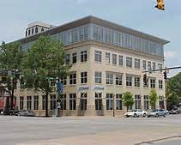

Special Meetings (Cont.)
Notice - contents
The special meeting notice must specify:
  Time
  Place
  Business to be transacted (agenda)
    Final disposition shall not be taken on any other matter at such meeting.
  RCW 42.30.080

Slide 20
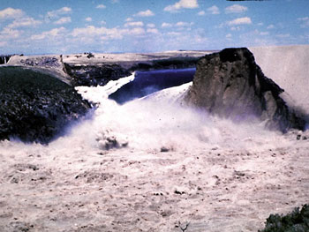
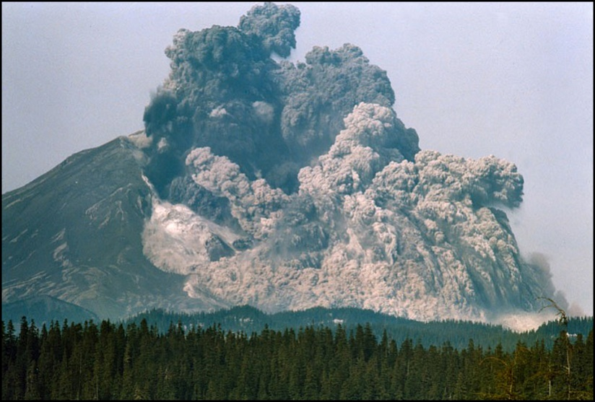
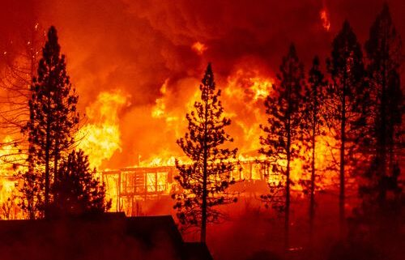
Emergency Meetings
Notice is not required when special meeting called to deal with an emergency.
Emergency involves injury or damage to persons or property or the likelihood of such injury or damage.
Where time requirements of notice make notice impractical and increase likelihood of such injury or damage.
  RCW 42.30.080(4)

Slide 21
Public Attendance
A public agency can’t place conditions on public to attend meeting subject to OPMA:
  For proceedings governed by OPMA, cannot require people to:
    Register their names or other information,
    Complete a questionnaire, or
    Otherwise fulfill any condition precedent to attendance .
Reasonable rules of conduct can be set (see upcoming slide on disruptive conduct).
Cameras and tape recorders are permitted unless disruptive.
Public Comment
  No “public comment” period required by OPMA.
  Agency specific statute may require “public comment.”
Proclamation 20-28.12
  RCW 42.30.040, AGO Opinion 1998 No. 15

Slide 22



Interruptions and Disruptions
The OPMA provides a procedure for dealing with situations where a meeting is being interrupted, the orderly conduct of the meeting is unfeasible, and order cannot be restored by removal of the disruptive persons.
Meeting room can be cleared and meeting can continue, or meeting can be moved to another location, but final disposition can occur only on matters appearing on the agenda. More details set out in the OPMA.
RCW 42.30.050

Slide 23

Executive Session
Part of a regular or special meeting that is closed to the public.
Limited to specific purposes set out in the OPMA.
Purpose of the executive session and the time it will end must be announced by the presiding officer before it begins.
Time may be extended by further announcement.
RCW 42.30.110

Slide 24
Executive Session (Cont.)
Specified purposes set out in OPMA. Includes, for example:
Real estate
  Site selection or acquisition of real estate
    Lease or purchase
    Public knowledge would likely increase price
Sale or lease
  Public knowledge would likely decrease price
  Final action selling or leasing public property must be taken in open meeting
Publicly bid contracts
  Review negotiations on performance
  Public knowledge would likely increase costs
Evaluate qualifications of applicant for public employment
National security
  Other purposes listed in RCW 42.30.110
RCW 42.30.110

Slide 25

Executive Session (Cont.)
Specified purposes set out in OPMA. Includes, for example:
Discuss Agency Enforcement Actions, Litigation or Potential Litigation
Three Requirements:
Purpose is to discuss agency enforcement action, litigation or potential litigation to which the agency, governing body, or a member acting in official capacity is, or is likely to become, a party.
Public knowledge regarding discussion likely to result in an adverse legal or financial consequence to the agency.
Legal counsel representing the agency is present. This executive session is not permitted just because legal counsel is present.
  Other purposes listed in RCW 42.30.110
RCW 42.30.110

Slide 26
Penalties for Violating the OPMA
A court can impose a $500 civil penalty against each member (personal liability) who knowingly attends a meeting in violation of OPMA; and $1000 for a subsequent knowing violation.
Court will award costs and attorneys fees to a successful party seeking the remedy.
Action taken at meeting can be declared null and void.
  RCW 42.30.120; RCW 42.30.130; RCW 42.30.060

Slide 27

Minutes
Minutes of public meetings must be promptly recorded and open to public inspection.
Minutes of an executive session are not required.
No format specified in law.
  RCW 42.30.035, Formerly RCW 42.32.030

Slide 28

Risk Management Tips
Establish a culture of compliance with the OPMA.
Receive training on the OPMA.
Review available resources; institute best practices.
Keep updated on current developments in OPMA; correctly apply law.
  Remember: the OPMA can change through amendments, or develop through case law.
  Remember: other laws can govern an agency’s meeting procedures.
Consult with agency’s legal counsel.

Slide 29


OPMA Training Requirements
The “Open Government Trainings Act” requires OPMA training for every member of a governing body within 90 days of taking their oath or assuming their duties. Refresher training occurs no later than every 4 years.
Training can be taken online, in person, or by other means.
Training resources, videos, and more information about the Act (a “Q & A”) are available on the Attorney General’s Office’s, Open Government Training web page: http://www.atg.wa.gov/OpenGovernmentTraining.aspx
RCW 42.30.205

Slide 30

OPMA Assistance
Consult your Attorney.
The Washington State Attorney General’s Office may provide information, technical assistance, and training on the OPMA.
The Attorney General’s Office may issue formal opinions about the OPMA for qualified requesters.
The Attorney General’s Office has helpful materials about the OPMA and on other open government topics and resources, on its website at: http://www.atg.wa.gov/Open-Government.
RCW 42.30.210

Slide 31



AGO Open Government Resource Manual
AGO OPMA Resources
AGO Guidance Document on Filling Vacant Positions
Updated October 31, 2016**
**Does not yet include statutory changes resulting from 2017-18 sessions.
Linked document within the AGO Open Government Resource Manual or ask your AAG for assistance.
* http://www.atg.wa.gov/open-government-resource-manual

Slide 32
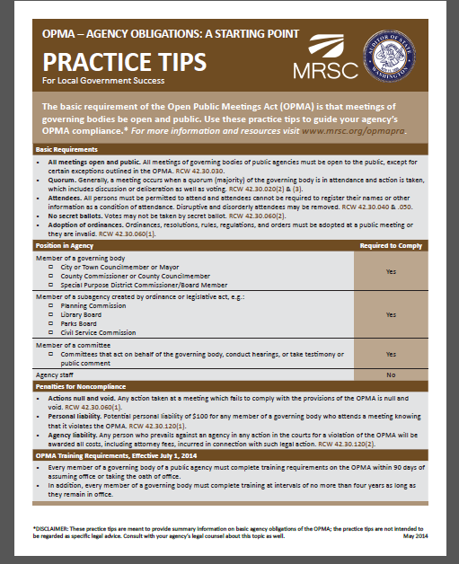
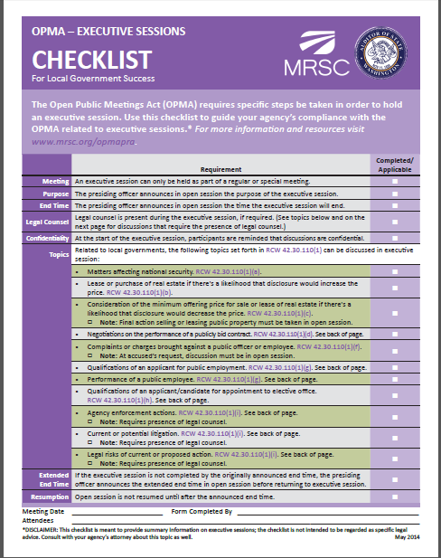
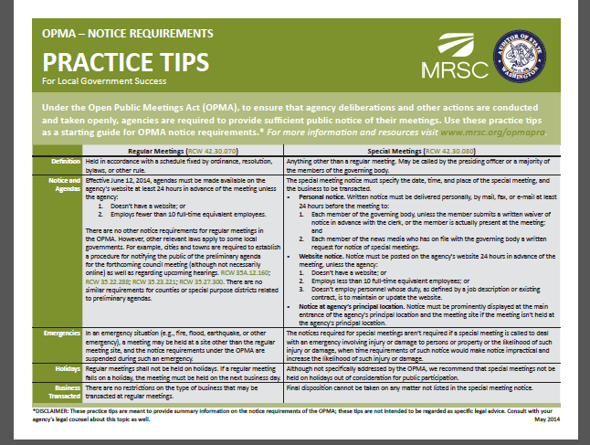
Municipal Research & Services Center – Another Resource
MRSC OPMA Resources

Slide 33
OPMA QUESTIONS?

Slide 34


Slide 35
Public Records Act
Chapter 42.30 RCW
Act II
Notes:
As we start off each of us give a brief introduction of ourselves.

Slide 36
Why Attend PRA Training
A little knowledge goes a long way.
Helps keep your agency out of court.
If you did err, training bolsters your defense; it is a mitigating factor.
Second, the court found that “proper training and supervision of the agency’s personnel” was a mitigating factor. CP at 905 (boldface omitted); Yousoufian II, 168 Wn.2d at 467. The court found that “[t]he evidence demonstrates an on-going and consistent process of education, supervision, and access to legal counsel to seek assistance,” with “both internal and external training available to employees.” Id. at 905. The records bears this out. See, e.g., CP at 397-98 (Hayes received both internal and external PRA response training), 457 (Knudson describing “reaching out to …Legal” when she was uncertain how to interpret RCW provisions), 471-72 (discussion Knudson’s formal training), 496 (Hayes training log), 572-74 (Kittitas County Sheriff’s Office public records release policy manual and training materials). The processing of Hoffman’s request was not a result of systemic problems.
Hoffman v. Kittitas County, Decided September 26, 2019.

Slide 37

Agency Best Practices and Personal Obligations We Will Cover
Public records & transparency principles – Why do I care?
What is a “public record.” – Do I have any?
How to recognize a records request. – Did I receive one and now what?
Using personal devices/accounts/files
  for agency business. – What are my public records obligations?
Searching and producing public records. – What do I have to do?
Some exemption basics. – What do I need to know?
Records retention basics. – How long do I need to keep records?
Enforcement and penalties. – What happens when I get it wrong?

Slide 38
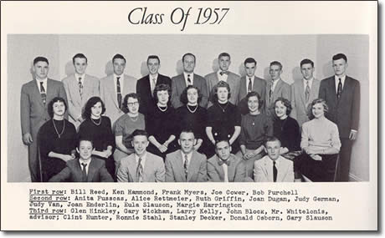
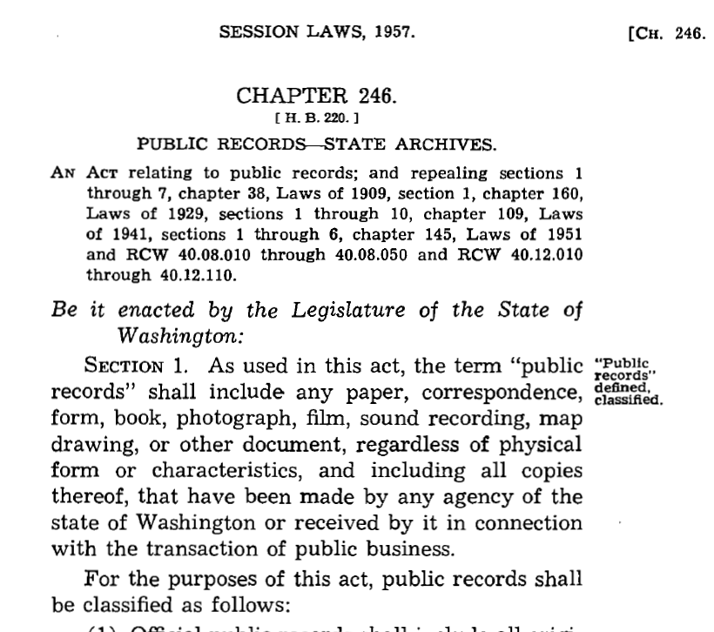
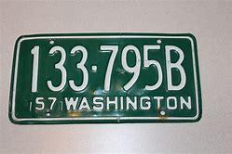

Two Records Laws
  Records Retention Laws – RCW 40.14
  Public Records Act – RCW 42.56
YOU create “public records” under these laws
38

Slide 39
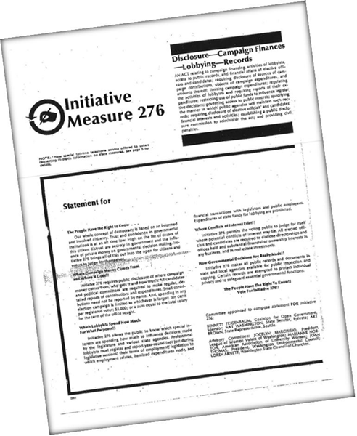
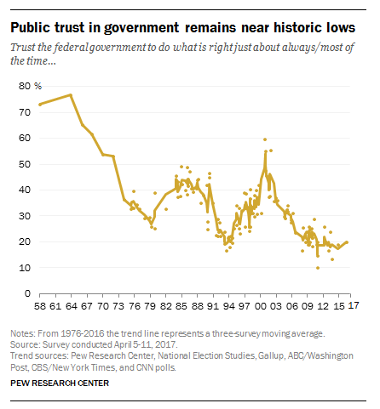
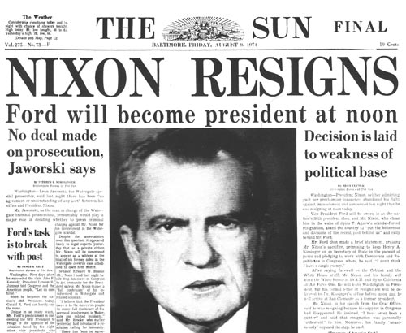
Public Records Act
Passed in 1972 – Initiative 276
RCW 42.56 (formerly RCW 42.17)

Slide 40
Proclamation 20-28.12
Open Public Meetings Act and
Public Records Act
20-28.8 suspends identified PRA provisions.
Focus is on reducing required in-person contact including suspension of:
  In person inspection requirements for up to 30 hours per week.
  Accepting in person requests.
  Requirement that facilities be made available for copying records.
  Five day response for requests other than those received electronically.
Proclamation 20-28 also suspends provisions of the OPMA, RCW 42.30. (See Part I.)
Expired December 7, 2020 at 11:59 pm. (Extended?)

Slide 41
Proclamation 20-64.3
Public Records Act – Contact Tracing – Personal Information
20-64 suspends public agencies from disclosure of identified records pursuant to PRA requests of the disclosure of records for any discretionary purpose not related to public health.
Personal information such as names, birthdate, address, etc., such as information found in customer or employee logs used or intended to be used for contact tracing, case investigation, or other public health purpose related to the COVID-19 emergency.
Any information such as names, birthdate, photographs, all telephone numbers, addresses that identifies or could be used to identify individuals that is obtained by public agencies while doing contact tracing, case investigations, or related public health outreach in response to the COVID-19 emergency.
Expired December 7, 2020 at 11:59 pm. (Extended?)

Slide 42


Why You Should Care
Examples of some PRA penalties/judgments for noncompliance:
  $1.77 M – City of Tacoma
  $600,000 – Snohomish County
  $575,000 – Snohomish County
  $550,000 – Clallam County
  $502,827 – L & I (upheld by State Supreme Court)
  $371,340 – King County
  $192,000 – LCB (included other open government claims)
  $175,000 – Mesa (reduced from $353,000)
  $150,000 – Jefferson County
  $85,000 – San Juan County
  $15,000 – Kittitas County (attorney fees $45,000)

Slide 43
PRA Applies to Records of:
State government agencies*
Local government agencies*
Individual members of the Legislature
* And to agencies that are the functional equivalent of public agencies.
PRA Does Not Apply to:
Court records (court files)
Records of certain volunteers
Private organizations or persons§ (see upcoming slide)
§Unless, for example, the records are used or retained by a government agency.
  RCW 42.56.010, Fortgang v. Woodland Park Zoo, 187 Wn. 2d 509 (2017),
  Shavlik, West v. Dawson Place __ Wn. App. 2d ___ (2019).

Slide 44

The PRA Evolves
Legislature
2019 & 2020
  1537 – Sunshine Committee recommendations
  1667 - Records consultation; grants; JLARC reporting
  1692 & 2020 – Employment investigations; harassment/stalking
  1888 – Employee Information and Notice
Courts
  2018 – 33 decisions
  2019 – 32 decisions
  2020 – 21 decisions
Executive
  Proclamation 20-28
  Proclamation 20-64

Slide 45
Touchstone
Public records of government agencies are presumed open.
Records or information in records can be withheld only by law (e.g. exemption in law).
Exemptions must be “narrowly construed.”
Non-exempt public records must be disclosed.
Location does not matter. Public record can be located in/on agency files/accounts/servers, or non-agency files/accounts/servers.
Public records must be retained pursuant to records retention laws.

Slide 46
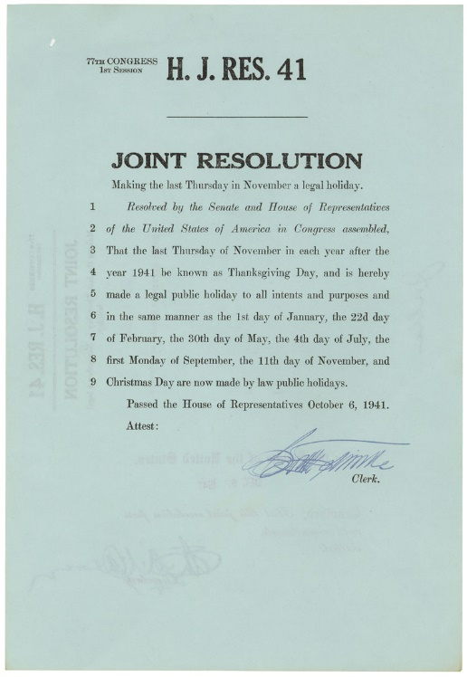
What is a Public Record
“Public record” means:
  any writing containing information
  relating to:
    the conduct of government
  - or -
    the performance of any governmental or proprietary function
  prepared, owned, used, or retained
  by any state or local agency
  regardless of physical form or characteristics.
RCW 42.56.010

Slide 47


Writing
  “Writing” includes “handwriting, typewriting, printing, photostating, photographing, and every other means of recording any form of communication or representation including, but not limited to, letters, words, pictures, sounds, or symbols, or combination thereof, and all papers, maps, magnetic or paper tapes, photographic films and prints, motion picture, film and video recordings, magnetic or punched cards, discs, drums, diskettes, sound recordings, and other documents including existing data compilations from which information may be obtained or translated.”
RCW 42.56.010

Slide 48

Personal Devices – Text Messages
Nissen v. Pierce County (2015)
Text messages sent and received by a public employee in the employee’s official capacity are public records of the employer, regardless of the public or private nature of the device used to create them; thus, even if the employee uses a private cell phone.
A record that an agency employee prepares, owns, uses, or retains within the scope of employment is a record “prepared, owned, used or retained by a state or local agency” under the PRA.
  An employee’s communication is “within the scope of employment” when the job requires it, the employer directs it, or it furthers the employer’s interests.
  This inquiry is always case - and record - specific.
  The Nissen court equated “official capacity” with “scope of employment” when referring to an elected official.

Slide 49

Personal Accounts - Social Media
PRA requests for public records in a local elected official’s personal residence, on a personal computer, and in a personal email account (2016); and personal Facebook site (2018).
Court of Appeals:
  West v. Vermillion, Puyallup (2016): Public records must be disclosed. The constitutions do not provide an individual a privacy interest in those public records. State Supreme Court denied review. (See upcoming slide on “privacy.”)
  West v. Puyallup (2018): Facebook posts on an elected official‘s personal site are public records if they relate to the conduct of government and are prepared within the scope of employment or official capacity.

Slide 50
SEIU 925 v. UW (Sept. 5, 2019)
Request for union organizing emails from UW faculty on agency servers.
Washington State Supreme Court:
Not all records located on an agency server are public records by virtue of their location on an agency device or account. Record must meet the definition of “public record.”
“Public record” definition has three prongs:
  1. any writing;
  2. containing information relating to the conduct of government or the performance of any governmental or proprietary function; and
  3. prepared, owned, used, or retained by any state or local agency regardless of physical form or characteristics.
  RCW 42.56.010(3)

Slide 51
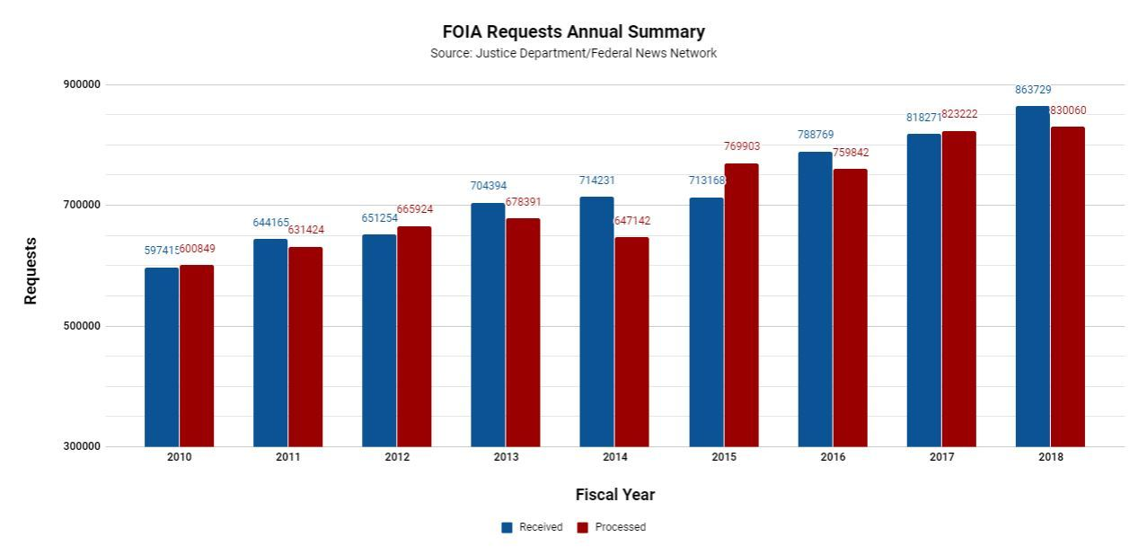
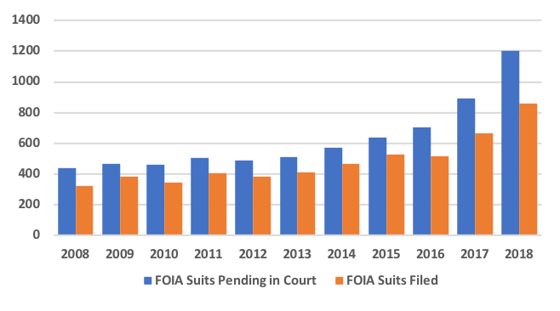
Request and Litigation Trends
The FOIA Project
Federal News Network

Slide 52

What does a PRA Request Look Like?
No official format is required. Agencies can recommend requesters use their form or web page. Must accept in person requests made during normal office hours.
Did you receive one?
Test: “FAIR NOTICE”
Examples:
Says “I am making a public records request for….”
On the agency’s Public Records Request form
Says it is a “Public Records Act” or “PRA” request
Cites PRA - RCW 42.56, “Freedom of Information Act” or “FOIA”
Says “Attention: Public Records Officer”
No specific format or form required.
BEST PRACTICE
REFER PERSONS TO PUBLIC RECORDS OFFICER.
IF YOU RECEIVE A COMMUNICATION SUCH AS THOSE ABOVE, GET IT TO PUBLIC RECORDS OFFICER ASAP.

Slide 53

From The Requesters Perspective
Persons must request identifiable public records from public agencies.
  At minimum, requester must identify documents with sufficient clarity to allow the agency to locate them.
  A request for “information” is not a request for “records” under the PRA.
Requesters can ask to inspect records, or request copies of records. Requests can be made via mail, email, in person.
Agencies can adopt procedures explaining where requests must be submitted and other procedures.
Generally no need to identify purpose of request, unless required by law (e.g., restriction on providing lists of individuals for a commercial purpose).
Requestors may make PRA requests in addition to discovery in a law suit.
RCW 42.56.520; RCW 42.56.080; RCW 42.56.040; RCW 42.56.100;
Hangartner v. City of Seattle; Bonamy v. City of Seattle; Hobbs v. State.

Slide 54
Initial response, “The 5-day letter”
The agency has five business days to respond to a public records request.
Agency response must do one of the following:
  Acknowledge receipt of the request and provide a reasonable estimate for a further response, provide records production date;
  Fulfill the request;
  Provide an internet address and link to the records on the agency’s website (which fulfills part or all of the request);
  Seek clarification; see upcoming slide; or
  Deny the request with an accompanying written statement of the specific reasons.
PRA Log: All agencies must maintain a log of all public record requests received including at least the following: 1) the identity of the requestor, if provided, 2) the date the request was received, 3) the text of the original request, 4) a description of the records produced in response to the request, 5) a description of the records redacted or withheld and the reasons why, and 6) the date of the final disposition of the request.
  RCW 42.56.520, 40.14.026

Slide 55
Third Party Notice
Third party notification is provided when an agency is releasing information that it believes is not exempt under the PRA, or another statute, but that an interested third party believes is not in the public interest.
RCW 42.56.520 – Prompt response required
- - - - -
(2) Additional time required to respond to a request may be based upon the need … to notify third persons or agencies affected by the request…
Some examples include:
  Information requested from agency staff’s personnel file.
  Proprietary information from contractors or clientele.
  RCW 42.56.520, Doe v. Benton County, Zink,

Slide 56
Records Management circa 1972
Searching For Public Records
Records Management
Today

Slide 57

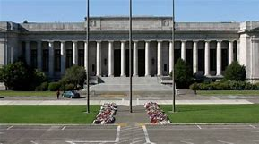
A Few Words from Our State Supreme Court on PRA Searches
Searching For Public Records
“The adequacy of a search is judged by a standard of reasonableness, that is, the search must be reasonably calculated to uncover all relevant documents.”
“What will be considered reasonable will depend on the facts of each case.”
“When examining the circumstances of a case, then, the issue of whether the search was reasonably calculated and therefore adequate is separate from whether additional responsive documents exist but are not found.”
“[A] search need not be perfect, only adequate."

Slide 58

Records Search Generally
An agency must conduct an adequate search for responsive records.
PRO must have an understanding of the agency’s organization and business.
The search should be reasonably calculated to uncover responsive records.
The search should follow obvious leads to possible locations where records are likely to be found.
If responsive public records are on or in employees’/officials’ personal devices, personal accounts, or personal files, those must be searched, too. May have to complete an affidavit to show the adequacy of your search.
The focal point of the judicial inquiry is the agency’s search process, not the outcome of the search.
The agency bears the burden of proof to show the adequacy of the search.
Provide missed records as soon as possible when located.
Can not charge for staff time searching or reviewing records.
.

Slide 59

Your Search & Production Responsibilities
For records that are not searched centrally by your PRO or designee:
YOU must promptly:
  SEARCH for your responsive records [agency devices/accounts, and any personal devices/accounts/files (next slide), other locations],
  RETAIN them (do not delete/destroy them), and
  PRODUCE them to your PRO/designee per instructions.
If you need more time, or if the request needs clarifying or you have questions, YOU must promptly:
  TELL that to your PRO/designee, and
  Explain WHY.
Cast a wide net and document all of your search efforts.
  Search terms used
  Locations searched (accounts/devices)
  Description of records produced & how
  Description of records not produced
  Other relevant information

Slide 60

Locations: Reminder - Public Records May Include Contractors’ Records
Agency contractors’ records are another possible location depending upon the request and the circumstances.
Public records may be agency records even if agency never possessed them (public records “Prepared, Owned, Used or Retained” by agency.)
Agency contract terms – Put contractor on notice about PRA and contractor’s responsibilities to preserve and provide public records.
Notify contractor of PRA request if contractor’s records are a reasonably possible location for responsive records.
  See also RCW 42.56.540 (third party notice).
Concerned Ratepayers Ass’n v. Clark County PUD No. 1
Telford v. Thurston County Board of Comm’rs (four-part test for when contractor is “functional equivalent” of public agency for PRA purposes; see also Cedar Grove Composting v. City of Marysville)

Slide 61

Records Retention – Abridged
KEEP PUBLIC RECORDS for
MINIMUM RETENTION
then
INTENTIONAL RETENTION
DESTROY
TRANSFER

Slide 62
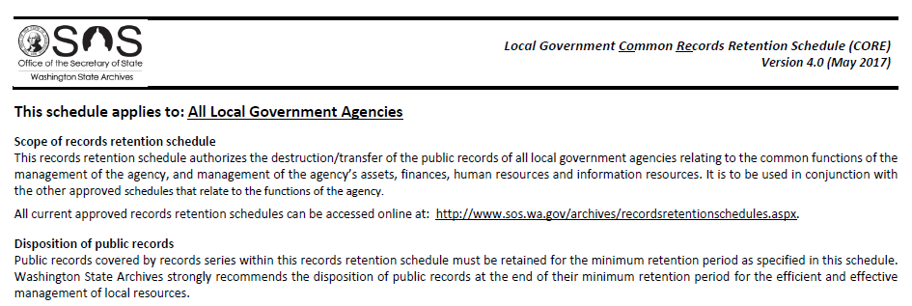
Know What Records You Need to Retain, and for How Long
PRA: Records requested under PRA request must be retained until request is resolved, even if scheduled for destruction. RCW 42.56.100.
Records Retention Laws: RCW 40.14.
Transitory Records – Retain for as long as you need them.
Local Government Common Records Retention Schedule (CORE)
Specialty schedules by department type.

Slide 63
Some Basics About Exemptions
Remember - Records are presumed open.
An exemption must exist in law (state or federal; PRA or other laws).
  A public record cannot be withheld based only on your promise of confidentiality.
  Exemptions are narrowly construed. Agency can lawfully withhold only exempt information that fits squarely within an exemption, must release other information.
An agency must, in writing, cite the exemption for the requester and provide a brief explanation. No “silent withholding.”
Requesters can go to court to challenge exemptions cited by an agency. If agency is incorrect, court can award civil penalties.
RCW 42.56.050; RCW 42.56.210 - .510; RCW 42.56.550

Slide 64
Exemptions (Cont.)
When withholding part (redacting) or all of a record, agency must describe record by date, type, authors/recipients, and total number of pages.
Agency must list exemption and give brief explanation.
This information can be provided to the requester in an “exemption log” or in other formats, so long as the required information is provided.
The agency bears the burden of proof to justify the exemption.
There is no PRA general exemption for a “draft.”
Redaction Methods:
  Sharpie
  Electronic Sharpie i.e. the black box
  Redaction Codes
RCW 42.56.050; RCW 42.56.210 - .510; RCW 42.56.550

Slide 65
A Sampling of Common Exemptions
Personal Information
Personal information in files maintained for employees, appointees, or elected officials of any public agency to the extent that disclosure would violate their right to privacy (information regarding misconduct is not exempt).
There is no general “privacy” exemption in the PRA.
If privacy is an express element of another exemption, privacy is invaded only if disclosure about the person would be:
  Highly offensive to the reasonable person, and
  Not of legitimate concern to the public.
  This means that if information does not satisfy both these factors, it cannot be withheld as “private” information under other statutes.
RCW 42.56.250(4)

Slide 66
A Sampling of Common Exemptions (Con’t)
Employee Information
Dates of Birth
Washington Supreme Court (October 24, 2019): Applying the required narrow construction requirements for PRA exemptions the Court did not find a statutory exemption authorized withholding the record. While Art. 1, sec. 7 may form a basis for withholding records it did not apply in this instance as dates of birth are not private and even if they were, there is a legitimate interest in their release.
SHB 1888 amends RCW 42.56.250
Photographs and month and year of birth in the personnel files of employees or volunteers of a public agency …. The news media, as defined in RCW 5.68.010(5), shall have access to the photographs and full date of birth.
Payroll deductions.
Notice requirements for information exclusively in an employee’s personnel, supervisor, training or payroll file.
RCW 42.56.250
Notes:
See 2SHB 1888
Morgan, change title from light brown to black. I notice on the previous page you have the title “A Sampling of Common Exemptions” starts at the far left, then the title “Personal Information” is indented as well as the bulleted sentences/paragraphs. On this page and the next page shouldn’t the titles be indented as well as the bulleted sentences/paragraphs because they are a part of “A Sampling of Common Exemptions” ? And they should look like the previous page (uniformly)?I hope I explained myself correctly. And pages 66 and 67 a “continued” from page 65 should that be at the top of the page? And I could be totally wrong that these three pages are interrelated Morgan. Thank you listening!

Slide 67
Commercial Purpose
A Sampling of Common Exemptions (Con’t)
General Rule: Requestors may use records for any purpose including a commercial purpose.
Exception: List of Individuals
Agencies are prohibited from releasing a list of individuals to a requestor when the intended use is for a commercial purpose.
Providing access to electronic records that can, by means of internal queries or sorting, display lists of individuals would be tantamount to providing access to lists of individuals which, if requested for commercial purposes, is prohibited.
Agency must make the determination based on the nature of the request, the identity of the requestor and any other information that may be available.
RCW 42.56.070(8), AGO Opinion 2019 No. 3, SEIU Healthcare 775 v. State.

Slide 68



Production of Records
When and How
If requestor asked to inspect records:
  Notify requestor of records availability and how long they will be available. (30 days per WAC 44-14-040.)
  The PRA prohibits any charge for inspection of records.
  Use of cell phone to take pictures of pages?
If records are to be produced:
  Inform requestor of fee (if any) and provide time for requestor to pay.
  Provide records to requestor.
  Agencies can produce records in installments, particularly for larger requests.
  Agencies can provide an installment by providing links to records on its website.

Slide 69

Enforcement & Penalties
PRA enforced by courts for claims listed in PRA.
A court can impose civil penalties: $0.00 to $100 per day per document. No proof of “damages” required.
Penalties imposed to encourage PRA compliance.
A court is to consider factors in requiring an agency to pay a penalty.
Plus, a court will award the prevailing requester’s attorneys fees and costs.
Special penalty provisions and court procedures apply to lawsuits involving inmate requests.
  RCW 42.56.550, RCW 42.56.565;
  Yousoufian v. Sims

Slide 70
General PRA Procedures
Under PRA, agencies must:
Appoint a public records officer.
Publish procedures describing certain agency organization, operations, rules of procedure, and adopt/enforce rules/regulations that:
  Provide full public access to public records.
  Protect public records from damage/disorganization.
  Prevent excessive interference with other agency functions.
  Provide fullest assistance to requesters.
  Provide most timely possible action on requests.
Publish fee schedule. No fee to inspect records.
Maintain a list of laws the agency believes exempts or prohibits disclosure.
Provide certain indexes of records.
Make non-exempt records available for inspection and copying during customary business hours for a minimum of 30 hours per week, excluding holidays.
Post customary business hours on the agency’s website and make hours known by other public means.
RCW 42.56.040; RCW 42.56.070 - .090; RCW 42.56.100; RCW 42.56.580

Slide 71
QUESTIONS?

